Slide 1
ML BASED INSURANCE PREDICTOR (USING RANDOM FOREST REGRESSOR)
On Subject of Data Science And Data Analytics
Group No: 2
Batch: 16

Slide 2
ML BASED INSURANCE PREDICTOR
Presentation By:
Shubham Patel (Course Participant)
(C.K.Pithawala College of Engineering and Technology, Surat)
Course Mentor:
Mr. Pranav Jaipurkar
(Knowledge Solutions India)
Group Members:
Dhruv Tilva
Shubham Patel
Dhwani Merai
Savidhi Mittal

Slide 3
PROBLEM STATEMENT
Create a ML models to predict the ‘Insurance cost’ with minimum MSE and RMSE and maximum R-Square score. Build the following models:
Multiple linear regressor (MLR)
Random Forest Regressor (RFR)
MLR with PCA
RFR with PCA

Slide 4
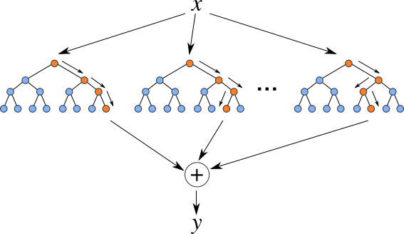
RANDOM FOREST REGRESSOR (RFR)
Random Forest Regression is a supervised learning algorithm that uses ensemble learning method for regression. Ensemble learning method is a technique that combines predictions from multiple machine learning algorithms to make a more accurate prediction than a single model.

Slide 5
RANDOM FOREST REGRESSOR (RFR)
Random forest builds multiple decision trees and merges them together to get a more accurate and stable prediction.
While random forest is a collection of decision trees, there are some differences.
PROBLEMS WITH DECISION TREES:-
Though decision tree is an effective regression model still there are a few discrepancies that can obstruct the fluent implementation of decision trees. Some of them are as mentioned below:
A slight change in data may lead to an entirely different set of data, thus causing the model to give incorrect predictions.
Decisions trees are very sensitive to the data they are trained on and small changes to the training set can result in significantly different tree structures.
Decision trees tend to find locally optimal solutions rather than considering the globally optimal ones.
To overcome such problems, Random Forest comes to the rescue

Slide 6
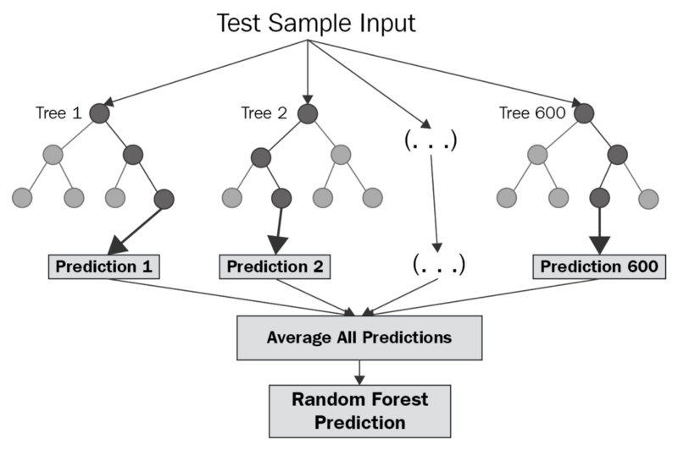
HOW RANDOM FOREST REGRESSOR WORK?
The diagram shows the structure of a Random forest. You can notice that the trees run in parallel with no interaction amongst them. A random forest operates by constructing several decision trees during training time and outputting the mean of the classes as the prediction of all the trees. To get a better understanding of the random forest algorithm, let’s walk through the steps:
Pick at random k data points from the training set.
Build a decision tree associated to these k data points.
Choose the number N of the trees you want to build and repeat steps 1 and 2.
For a new data point, make each one of your N-tree trees predict the value of y for the data point in question and assign the new data point to the average across all of the predicted y values.
A Random Forest Regression model is powerful and accurate. It usually performs great on many problems, including features with non-linear relationships.

Slide 7
Building Random Forest Regressor (RFR)
Now let’s try to build our random forest regressor model.

Slide 8
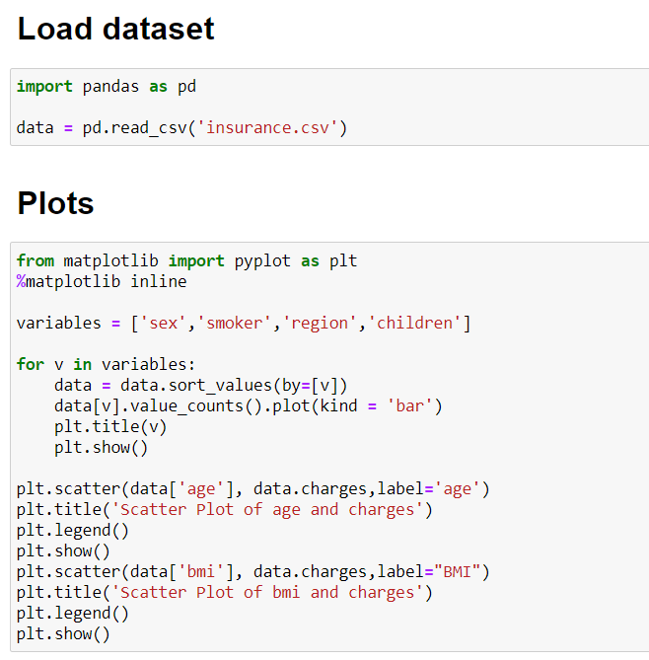
Step 1: Identify your dependent (y) and independent variables (X) And Plotting graphs
Our dependent variable will be the insurance cost while our independent variables are the remaining columns left in the dataset.
Now we know our dependent and independent variables let’s try to visualize this data.

Slide 9
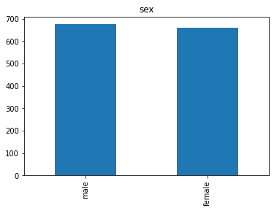
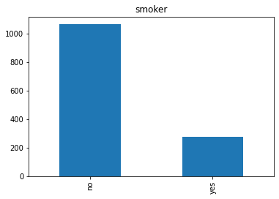
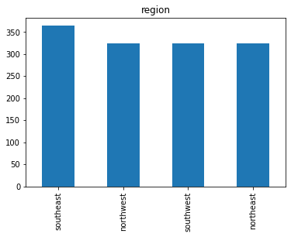
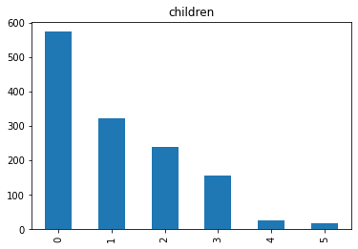
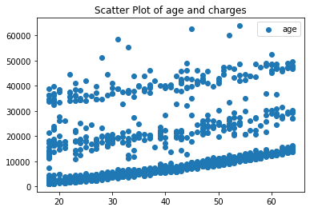
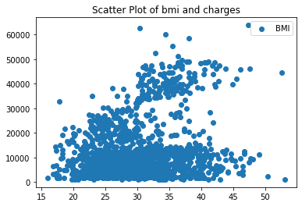
Data visualization using matplotlib

Slide 10
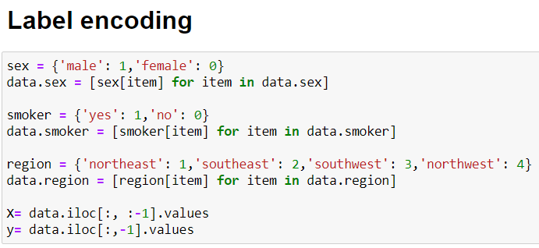
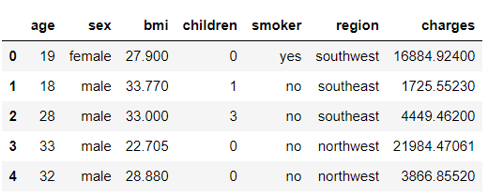
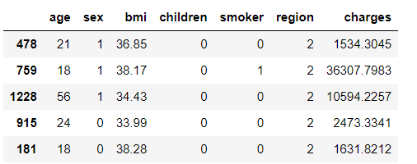
Step 2: Label encoding
Here, in our dataset the columns ‘sex’, ‘smoker’ and ‘region’ have categorical values so we need to apply label encoding to convert categorical data into float or int type data.

Slide 11
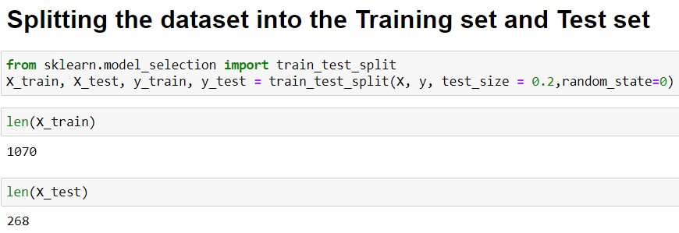
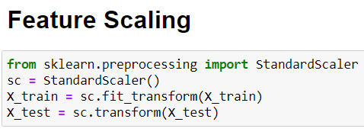
Step 3: Splitting the dataset into training and test set Step 4: Feature Scaling
Step 3
SKLEARN library’s train_test_split is used to split the dataset into training and testing data.
Step 4
Feature Engineering becomes important when the number of features are very large. One of the most important use of feature engineering is that it reduces overfitting and improves the accuracy of a model.

Slide 12
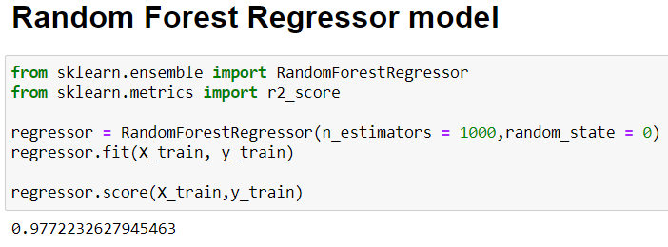
Step 5: Training the Random Forest Regression model on the whole dataset
From the sklearn package, we import the RandomForestRegressor, and assign it to a variable. The parameter n_estimators creates n number of tree. We passed in 1000. so the model will create the 1000 trees on training data.

Slide 13
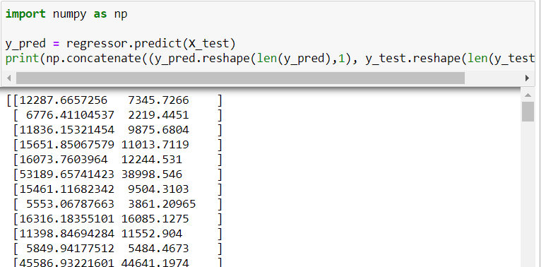
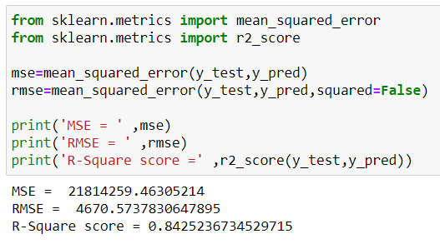
Step 6: Predicting the test set results
Now, we have created a random forest regression model, we must assess is performance.
.R² score tells us how well our model is fitted to the data by comparing it to the average line of the dependent variable.
We achieved an accuracy score of approximately 84%.

Slide 14
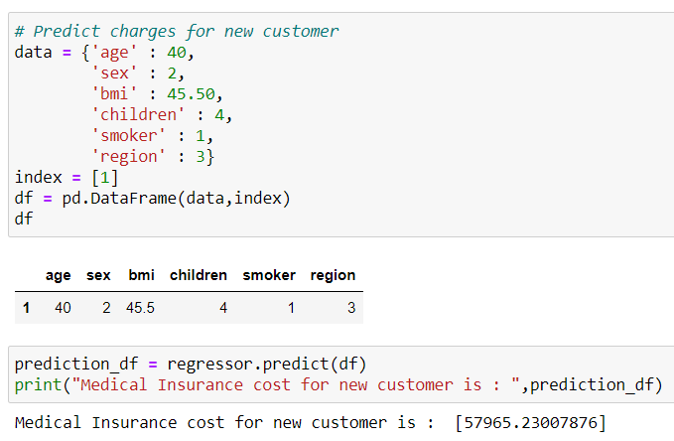
Predict the charge for new customer
Now, let’s predict the insurance cost of new customer using arbitrary values.

Slide 15
Thank You!!

